Slide 1





Slide 2






Slide 3


Slide 4


Slide 5










Slide 6















Slide 7




Slide 8










Slide 9


Slide 10


Slide 11


Slide 12



Slide 13












Slide 14














Slide 15


Slide 16



Slide 18






Slide 19








Slide 21


Slide 22


















Slide 23








Slide 24













Slide 26






Slide 27



java.exe …
PAYSLIP GENERATION
Payslip content Anna Smith; Days off 2; Income $1870 Sent via email to Anna.Smith@globomanticshr.com #####
Payslip content Billy Lech; Days off 2; Income $860 Sent via email to Billy.Lech@globomanticshr.com #####
Process finished with exit code 0

Slide 28
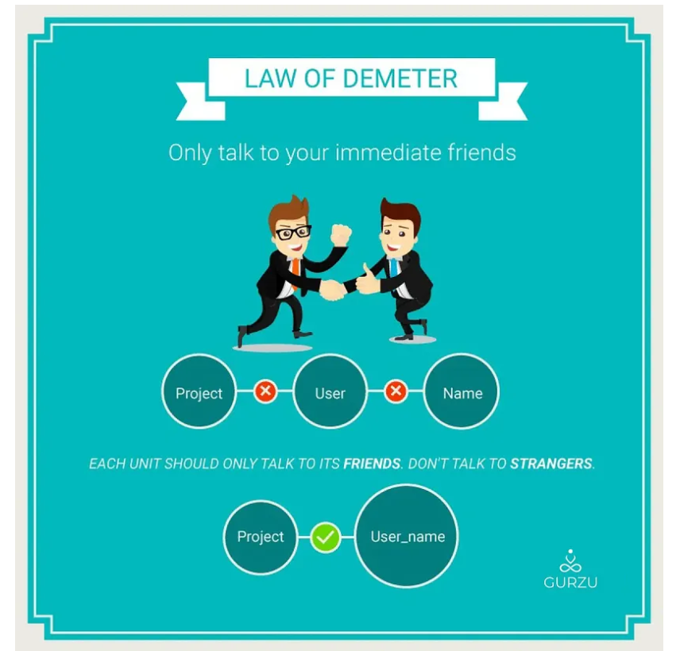
Law of Demeter

Slide 29
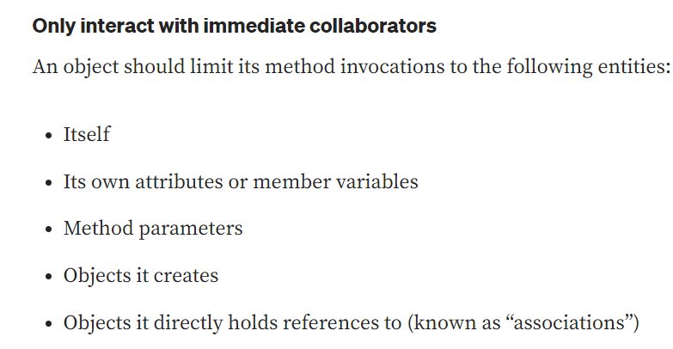
Guidelines of the Law of Demeter

Slide 30
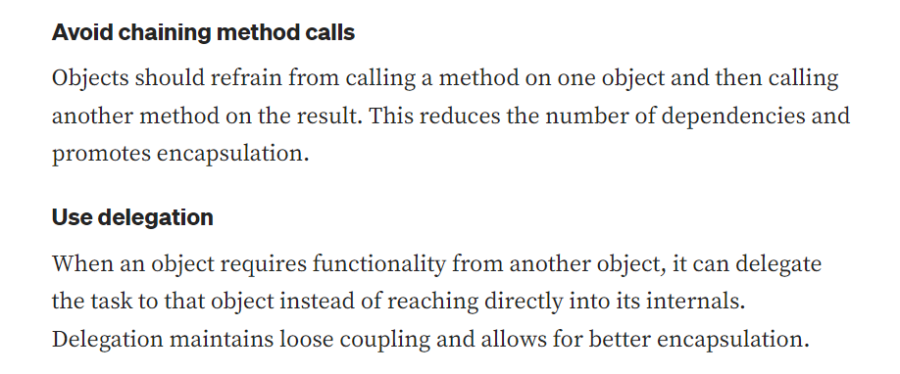
Guidelines of the Law of Demeter

Slide 31


Examples with the Law of Demeter (adhering to the principle)
Example violating the Law of Demeter

Slide 32


